Slide 1

Fire Safety
The Healthcare Company Representative’s guide
Notes:
The purpose of this program is to educate the Healthcare company representative about the importance of fire safety. Due to the various healthcare settings you may be required to provide your product, knowing what fire risks exist is very important to your safety and that of your clients. This course will educate you regarding what causes fires, how to prevent them, and what to do should you be involved in a fire while providing healthcare services.

Slide 2
Course Outline
The Basics (Cause and Prevention)
What to do in a fire (Response and Standards)
Fire and medical devices
Fire safety in specialty locations (Surgery and Home)
Notes:
This course is broken into 4 sections. Section 1 will cover the basics included in any fire safety course: what causes a fire and how do you prevent it. Section 2 will cover what you do once a fire has already occurred. Depending on the setting, your responsibilities may vary so it is important for you to know how to respond should you need to. Section 3 will look at the association between fire and medical devices such as lasers and other medical equipment. Finally section 4 will be a specialty area for those of you who will provide services in the operating room or in a home health setting.

Slide 3
Objectives
Discuss the basics of what causes a fire in healthcare settings and prevention strategies
Discuss the definitions and use of acronyms associated with fire safety such as RACE and PASS and how to respond in a fire.
Discuss the importance of knowing locations of OSHA standards such as fire exits, fire extinguishers and emergency plans
Discuss association between equipment maintenance, electrical, laser and radiation safety with fire safety
Discuss fire safety in the surgical suite
Discuss fire safety in patients’ homes
Notes:
These are the objectives of this course. After completion you should be able to discuss the causes of fires in healthcare settings and what you can do to prevent them. You will also learn common acronyms used in healthcare setting such as RACE and PASS, and the importance of knowing each facilities emergency plan. You will learn how various products, such as lasers, may lead to fires. You will also de able to discuss specific information regarding fire safety in surgery and home health settings.

Slide 4
Fire Safety
The Basics
What causes it?
How do you prevent it?
Notes:
This is section 1: the basics. Before you can prevent or extinguish a fire, you should know what causes them. The risk of fire in healthcare settings is very high and very dangerous. This risk exists all the time.

Slide 5
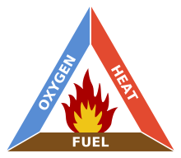
How do fires start?
Three things are needed for a fire to occur:
Oxygen
Heat
Fuel
This is know as the
fire triangle.
A fire will not occur unless all three elements exist at the right time in the right amounts
Notes:
In order to prevent fires, you must know what starts them. There are 3 necessary components to create a fire: oxygen, heat and fire. These three items make up what is known as the fire triangle and all of these components exist in the healthcare setting all the time.

Slide 6
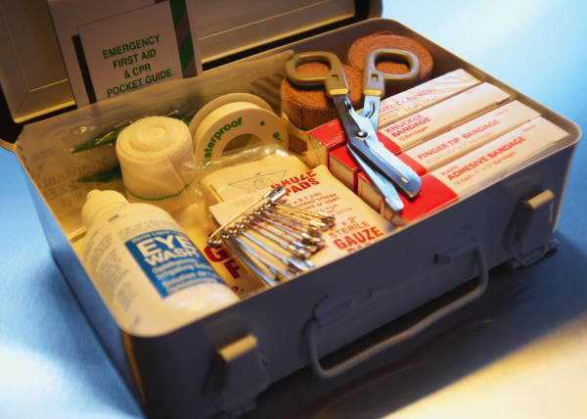
FUEL
Many medical items in healthcare facilities and the home may act as fuel for fires
Some examples include:
Bandages
Ointments
Alcohol-based products (antiseptics)
Bed sheets
Latex items such as catheters
Any item that burns easily…
Notes:
Now lets discuss the specifics of each section of the triangle. The first component was fuel. Basically any item that will burn easily can act as fuel for a fire. Healthcare settings, as well as our homes, are full of medical items that can act as fuel. Can you think of some of these? (pause) Commonly used items include but are not limited to: bandages, various ointments, alcohol-based products, linen and rubber items.

Slide 7
OXYGEN
What makes oxygen dangerous in healthcare?
Large amounts of oxygen containing devices
Use of high concentrations of oxygen in healthcare settings
Oxygen is around us all the time.
Notes:
Component 2: Oxygen. Oxygen is what we breathe. How can this be dangerous? It’s everywhere. Well in healthcare settings oxygen containers are stored in large numbers. If they are stored improperly, they can be very dangerous. Also, many medical conditions require patients to use higher does of oxygen than contained in normal air. These higher concentrations can also help feed a fire. This is especially true in setting such as surgery where 100% O2 may be used. In addition, patients wearing oxygen delivery systems should never smoke at the same time. This is a VERY dangerous combination.

Slide 8
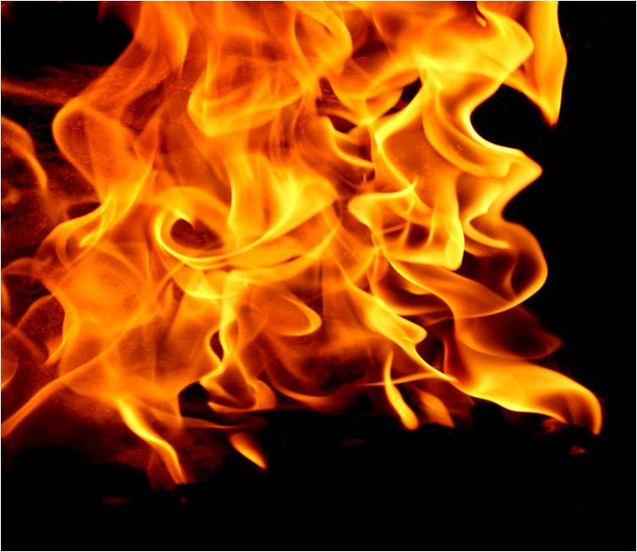
HEAT
Smoking
Lasers
Sparks from equipment
ESU
Notes:
The 3rd component to the fire triangle is Heat. Heat can occur from many sources. Smoking cigarettes is often seen as a harmless activity by staff and patients but when close to other fire producing components it can be very dangerous. Medical equipment can also act as a source of heat. Use of lasers or electrical surgical units (ESU) also known as a bovine, can cause fires. Also, equipment in poor condition can spark from faulty cords and other damage adding the heat component.

Slide 9

Prevention and the Fire Triangle
FUEL
OXYGEN
HEAT
Keep alcohol-based products in a locked fire proof box
Store O2 tanks properly. Use low dose when possible
NEVER smoke while wearing O2
Notes:
So now you know what causes fires, how do you prevent them. Even when everything is done correct fires can still occur but some simple strategies to prevent fires include: keeping all alcohol-based products in an approved fire box, properly storing Oxygen tanks to prevent damage and using the lowest dose of oxygen that is acceptable for the medical condition and never smoking near oxygen devices.

Slide 10
Review
Click to see the answer to each question
What are the three components of the Fire Triangle?
  Fuel, Oxygen, Heat
What is one example of each component?
  Antiseptic, Oxygen tanks, Laser
What is one prevention strategy to remove each component?
  Fire boxes, Proper storage, Do Not smoke
Notes:
So lets review what we have learned so far. What are the 3 components needed to start a fire, also know as the fire triangle? (pause) Click for the answer. Next what is an example for each of these components? These are just suggestions and there are many more items that could fall into these categories. Finally, what is one possible prevention strategy that can be done to remove each of the 3 components? (pause) Again, these are just examples. There are many things you can do to prevent fires but even in the best situation, fires may still occur. This is why it is important to know what to do if you are in a fire… our next section.

Slide 11
Fire Safety
What to do in a fire
How do you respond if a fire occurs?
Notes:
This is section 2: what do you do? Even in the best situation fires can still occur. As a company rep what is your responsibility if you are present in a fire? Does this action change based on setting? Do you know the standards that are in play? Do you understand the meaning of the various acronyms used such as Code Red or RACE? It is important to be educated about your place in a fire safety action plan to ensure your safety as well as others.

Slide 12
Where do fires occur?
Fires can occur anywhere the 3 elements of the fire triangle exist.
Common areas:
  Lab
  Laundry and storage areas
  Patient rooms
  Staff lounges
  Procedure suites (less common)
Notes:
Fires can occur anywhere but there are several areas in a healthcare facility that they are more prone. Areas such as the lab and storage areas, where there can be an abundant about of the 3 necessary elements, make them more at risk. Patient rooms where patients or family members may try to smoke while using oxygen or in the presence of alcohol hand scrubs can also cause fires as well. The use of faulty electrical equipment in a staff lounge may also increase risk. Finally, although less common, procedural areas especially the operating room are at risk of fire due to the amount of equipment and oxygen used.

Slide 13
Life Safety Code
Standards that healthcare facilities use to base their fire safety programs come from the National Fire Protection Association (NFPA) Life Safety code
Emergency exits must be clearly marked, well lit, and unobstructed
Fire alarms and appropriate extinguishers must be available
There must be fire doors and smoke partitions
There must be a fire evacuation plan
Notes:
Accrediting agencies such as JCAHO and CMS mandate that healthcare facilities follow certain standards regarding fire safety. These standards are based upon the National Fire Protection Association’s Life Safety code. Some of the information covered in this code are the necessity of appropriately marked and easily accessible emergency exits. There must be functioning fire alarms systems and fire extinguishers available. Fire doors must be automatic, unobstructed, and smoke partitions exist to prevent the fire from spreading to other areas. And finally, each facility must have a fire evacuation plan. This information should be known by all staff and representatives in the facility. More information about each of these topics will be explained in the following slides.

Slide 14
What should you do in a fire?
RACE
R: Rescue
A: Alarm
C: Confine/Contain
E: Evacuate/Extinguish
Code Red: often used to publically denote a fire without causing panic
Notes:
If you are in a facility when a fire is found, you may hear the term Code Red called overhead. This is a term used in many facilities to denote to the staff that a fire is present in the facility without scaring patients and visitors. If you hear this you should follow the instructions of the unit’s charge nurse or manager as to what is requested of you. Although this may be a fire drill, you should always assume that it is a real fire. This person will be in charge of making sure the evacuation plan is followed and will disseminate duties as needed. Another acronym you should be aware of is RACE. This is the basic response structure during a fire. If the fire is in your area, you should help rescue any patients who are in that area. If the fire alarm has not already been activated, you would do so after everyone is safe. Fire doors and smoke partitions will help with confining and containing the fire, as well as closing the door to the room the fire is located. Finally the facility's evacuation plan should be followed. If it is safe to do so, the fire may be extinguished. If there is any doubt, confine the fire and wait for proper authorities.

Slide 15
Fire Extinguishers
What should you know?
Where are they?
What type do you have?
How do you use it?
Notes:
Even if you are not asked to help extinguish a fire, there are things about them you should know. First, you should know where the fire alarms and extinguishers are in every facility to go to. This is true if you provide care to patients’ homes as well. Many resident care facilities and apartment complexes will have extinguishers outside for needed use. You also need to know what type of extinguisher it is. There a three types and each is used for something different. We will discuss this in the next slide. Finally, if you are called upon to operate the extinguisher, you need to know how. A simple mnemonic known as PASS will help you in this stressful situation.

Slide 16
Fire Extinguishers
Fire extinguishers are one of the best ways to put a fire out once it occurs.
Types
  Class A: linen, plastic, paper (water)
  Class B: oil, gasoline (CO2)
  Class C: electrical (dry chemical)
Notes:
As previously discussed, there are 3 types of fire extinguishers. Class A is primarily for paper and plastic items. Class B is more for oil fires such as gasoline or kerosene. Class C, are dry chemical extinguishers used for electrical fires. It is important to know which type you have. Using a water extinguisher on an oil fire would make the fire spread. Most procedural areas such as surgery will have a CO2 extinguisher.

Slide 17
How to put out a fire
PASS
  P: Pull pin
  A: Aim at base
  S: Squeeze the handle
  S: Sweep Side to side
Notes:
PASS is a simple way to remember how to use a fire extinguisher. The P stands for pull the pin. A stands for aim the nozzle at the base of the fire. You should stay at least 6-10 feet away if possible for your safety. The first S stands for squeeze the handle in short bursts. Finally, sweep side to side at the base of the fire.

Slide 18
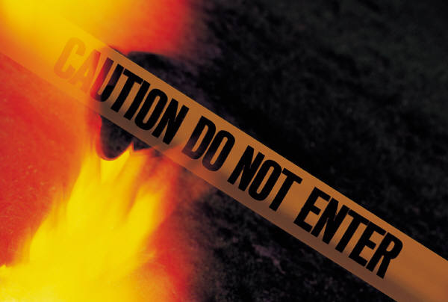
Evacuation: Key points
Avoid elevators (Use stairs when possible)
Don’t pass the location of the fire
After a room has been cleared, it should be marked as empty
Do not open a door that is warm to the touch
Don’t be a hero- follow the directions of the person in charge
Notes:
Just a few points you should keep in mind if you are ever involved in a fire evacuation. First of all, follow the directions given to you by the person in charge. Don’t go off on your own. Persons may become injured looking for you thinking you are still in the fire zone or you may become trapped in a dangerous area. This is why you should not cross past the fire area and avoid elevators. Also, never open a door that is warm to the touch. This is a sign that a fire may be present and is probably to large for you to tackle on your own. Don’t be a hero. Wait for trained professionals rather than putting yourself or others in danger.

Slide 19
Sample Fire Drill Form
Fire drills are very important to practice.
Fire drills helps you commit these tasks to memory to in a real fire you are prepared.
Notes:
Fire drills are a great way to practice these skills so in a real fire you are prepared. Although you should never have to fill one of these out, it is a great tool to review what should be done.

Slide 20
Review
Click to see the answer to each question
What are the three areas prone to fires in healthcare settings?
  Lab, Storage areas, Patient rooms
What does RACE stand for?
  Rescue, Alarm, Confine, Evacuate/Extinguish
What does PASS stand for?
  Pull pin, Aim at base, Squeeze handle, Sweep side to side
Notes:
So lets review what we have learned so far. What are 3 possible areas prone to fires in a healthcare facility? (pause) Click for the answer. These are just examples. Remember, fires can occur at any time, anywhere. Next what does RACE stand for? Finally, what does PASS stand for? (pause) Click the question of the answer.

Slide 21
Review
Click to see the answer to each question
Give an example of each type of fire extinguisher?
  Class A: paper
  Class B: oil
  Class C: electrical
Notes:
Finally, lets review the types of fire extinguishers. Please give an example of each type of the three fire extinguisher classes. Be sure to look at the fire extinguisher before you use it so you know you have chosen the appropriate type for the fire in question. Click on the slide for an example of each type.

Slide 22
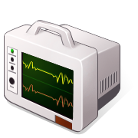
Fire Safety
Fire and Medical Devices
Electrical, Laser, Radiation

Slide 23
Electrical Safety and fires
Most equipment in healthcare facilities are electric
  Vital Sign Monitors
  Beds
  Anesthesia Machines
  ESU
  Infusion devices
Electrical fires from faulty equipment are a risk
Notes:
When you are in any healthcare setting or even a patient’s home you will come into contact with electrical equipment. You may even be bringing in electrical equipment of your own company. Some common examples of equipment you may come into contact are listed above such as monitoring equipment. Fires are a risk with all electrical equipment. A spark from a fault cord in the right environment is all it takes. In the next slides, you will learn how to identify and report electrical hazards, the importance of keeping company equipment in proper function, and how to prevent accidents that could lead to a fire.

Slide 24
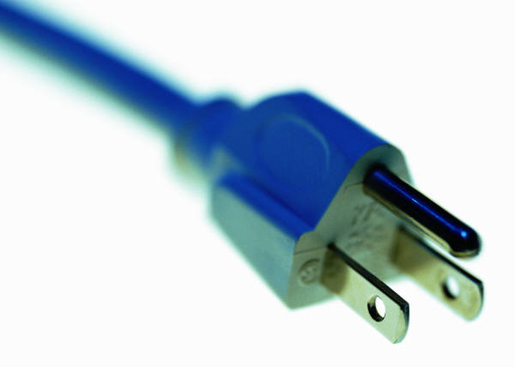
Short lesson on Electricity
Electricity requires a conductor (fluids, ground)
Electricity flows in a closed circuit.
You can be made a part of this circuit and get shocked.
Notes:
Since we are talking about electricity we might as well do a short overview of electricity in general. The two main points you could be aware of is that electricity requires a conductor and it travels in a closed circuit or loop. Fluids, such as water or body fluids, make great conductors. So, be careful where you stand especially in operating suites. Also, be careful what you touch. A faulty piece of equipment could leak an electrical current. If you touch it, that electricity could travel down you to the ground making you a part of the loop. Electrical shocks can be life-threatening.

Slide 25
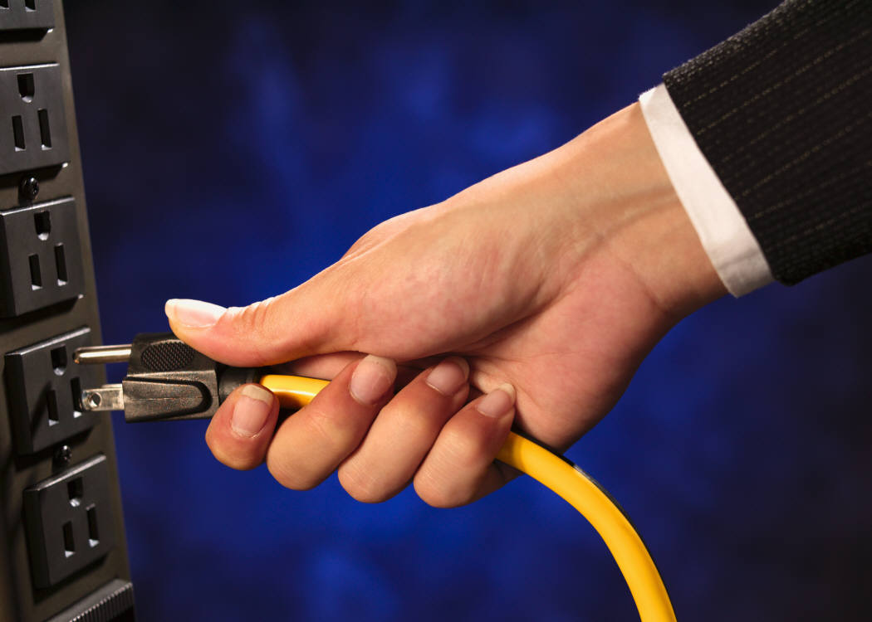
Signs of electrical shock
Severe burns
Convulsions and spasms
Dysrhythmias (irregular heartbeat)
Apena (absence of breathing)
Notes:
This slide is just for your information to demonstrate how severe a shock can be. Shocks can cause burns, stop breathing, and affect heartbeat.

Slide 26
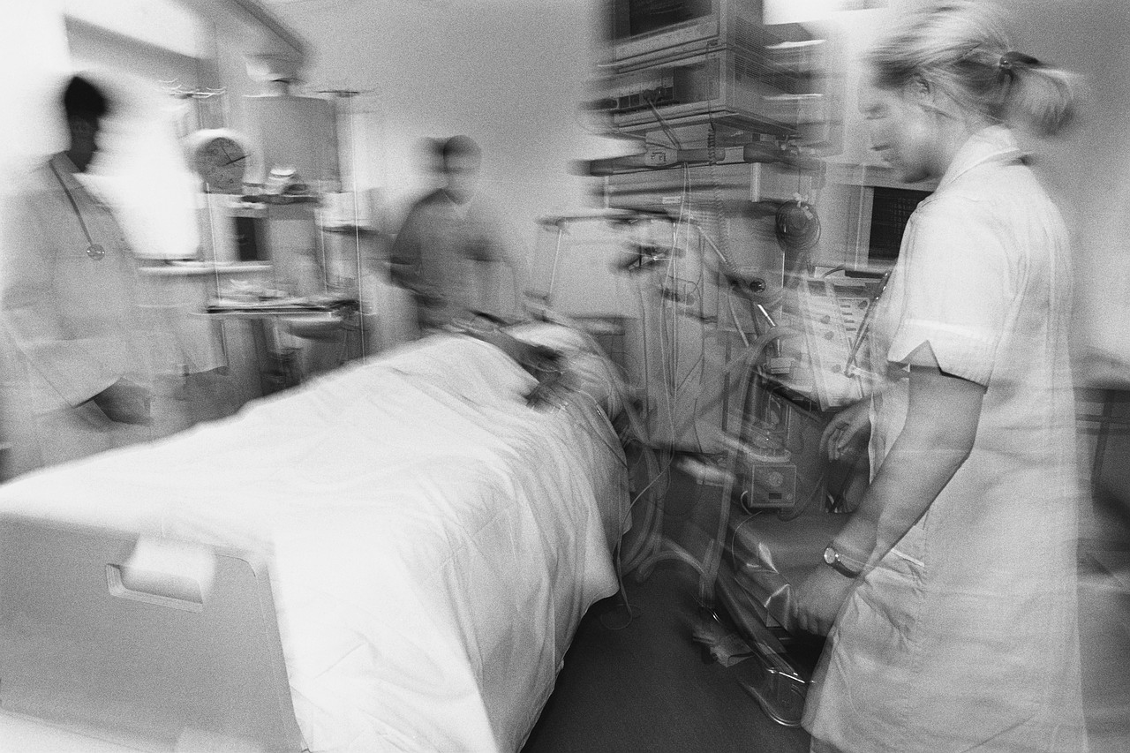
Protect your equipment
Have it checked by Biomed whenever you bring into a facility
Check it for signs of damage, especially to power cords
Watch for malfunctions or heat
Remove from service if there is a burning smell or electrical shock
Equipment damage can lead
to a fire!
Notes:
Whenever you bring any equipment into a healthcare facility it must be check by the facility’s biomed department. Although, you should also check the equipment before you bring it in and monitor it during use. Keep an eye on power cords. Look for frayed cords or burning smells. Look at the outside of the device. Be sure there are no cracks from drops and all accessory cords and covers are in place. Any damage to the equipment can cause shocks or overheating which can lead to an electrical fire.

Slide 27
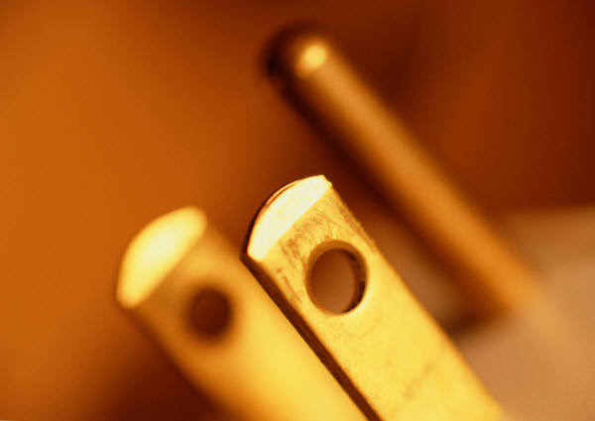
Prevention Techniques
Don’t use equipment if power cords are frayed
Don’t twist or bend cords
Always hold plug to remove from outlet
Don’t place equipment or run over cords with gurneys
Only use devices with approved 3 prong plugs
Only use approved extension cords and avoid overload
Notes:
Cord damage is a common way for equipment to malfunction and lead to a fire. This slide shows some simple prevention techniques to keep in mind when you handle equipment. For instance, you should never use a device if the electrical cord is not intact. With that in mind, be careful how you handle these cords. Don’t bend them or put undo strain on them because this can lead to fraying. Also, always hold the plug when you remove the device from an outlet rather than pulling on the cord. Finally, always plug the device in properly. When possible plug the device directly into the wall. Use proper outlets and extension cords. If you have any question you should refer to the facility’s biomed department.

Slide 28
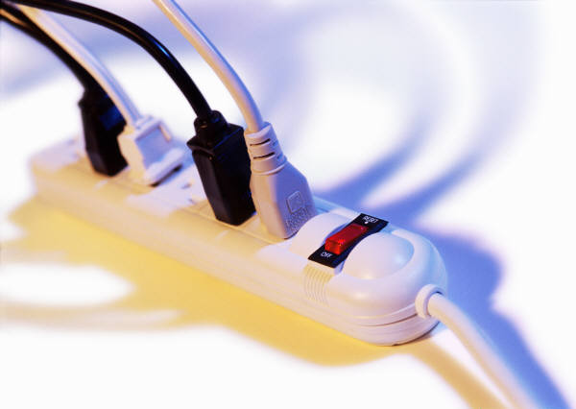
Prevention Techniques (cont)
Don’t cover electrical cords with blankets, etc
Don’t let the cords come into contact with fluids
Be sure you know how to properly use the equipment
  Know signs of malfunction/troubleshooting
  Know if other equipment may cause conflicts
Notes:
Just a few additional points. Depending on where your equipment is being used, there may be a risk of the cords getting covered by patient linen or staff attempting to prevent tripping by covering loose cords with a blanket. This is a fire risk as well, providing fuel for a fire. Also, in many setting such as the surgical suite the risk of electrical equipment getting splashed by body or other fluids are a risk which could short-out the equipment causing sparks and/or a fire. Finally, although it might seem like a given, you want to be sure you know how to properly use any equipment in your care. This included knowing any signs of a malfunction, including the meaning of all warning lights and how to deal with them. Some equipment can cause malfunctions when used near other equipment. One of the most common situations is two large devices causing an overload when plugged into the same circuit. Be aware of the wattage of your equipment and be prepared in case there is a conflict.

Slide 29
Review
Click to see the answer to each question
What are three things you can do to help prevent an electrical fire?
Don’t use equipment with frayed cords
Don’t allow fluids to come in contact with equipment
Remove any piece of equipment that is malfunctioning
Notes:
So lets do a short review. What are 3 things you can do to help prevent an electrical fire? We have reviewed several ideas. When you are ready, click the slide to see the answers. These are just suggestions and not the only right answers.

Slide 30
Laser/Radiation Safety and Fires
Notes:
In addition to electrical safety and fire prevention, you may also be exposed to other medical equipment such as radiation devices and lasers. It is important to learn a little about each so you can protect yourself when around them and also how each can contribute to fires. Knowing the risks will equip you with methods to prevent accidents.

Slide 31
Laser Safety
Risks associated with lasers:
Smoke (plume) from lasers can cause irritation, infection and cancer
Lasers are electrical pieces of equipment and often have fluid components
Lasers within healthcare settings, such as the OR, can prove to be a fire hazard
Notes:
Although very helpful for certain disease processes, lasers can pose quite a risk to those around them. Lasers produce smoke, also known as plume. This plume can be very hazardous. It can irritate eyes and airways but it can also spread infectious agents and has even been link to cancer. In the previous section we discussed electrical safety. Lasers are electrical pieces of equipment and can put you at risk of electrical shocks and fires. Lasers are usually large pieces of equipment with many cords. They can be a trip hazard but those cords can also get run over and damaged or come into contact with fluid. Many lasers have fluid components that can leak and cause electrical shock and/or fires. In most Ors, the scrub person will keep water on the back table in case of a fire but this can cause be a risk too since it could spill on the floor or electrical devices causing damage. The key thing to remember is to be alert when dealing with any medical equipment. Specifically to fire safety, fires need 3 things to occur and all three or present anytime you are in a surgical suite using a laser.

Slide 32
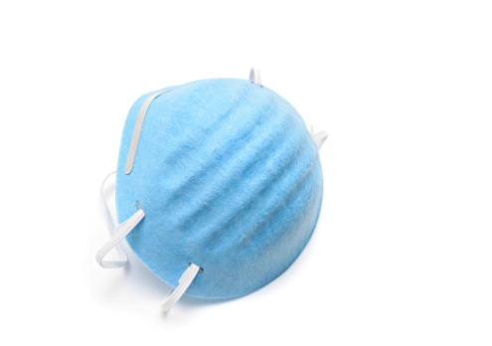
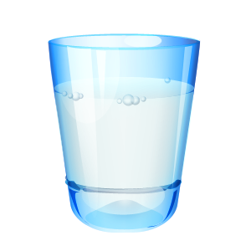
Prevention of Laser Accidents/Fires
Wear laser masks and goggles
Look for “laser in use” warning signs
Know where the fire extinguisher is and how to use
Use laser surgical equipment (non-reflective)
Use smoke evacuator
Keep control of fluids
Avoid/report damage to equipment and cords
Keep laser in standby when not in use
Anesthesia should use laser safe ET tubes
Notes:
There are many things that can be done in the healthcare setting to prevent Laser accidents and fires. This slide shows some examples but it is not an exhaustive list. Some of the items may not be within your control but it is important that you know what the best practices are for your safety. First of all, be aware of your environment. Always look for “laser in use” signs before you enter a room. If you are responsible to the laser, you should be sure to inspect your equipment before use and report any damage. Always remember to follow the facility’s policy regarding having equipment checked out by biomed when brought in from the outside. When you are in the room, when possible use a smoke evacuator to limit the spread of plume. Be sure to wear approved laser masks and safety goggles. Be sure staff is using non-reflective laser surgical instruments. Laser beams can hit a reflective piece of equipment and bounce back causing injury. Always keep the laser in standby when it’s not being used to prevent accidental firing. These are all simple strategies you should employ every time a laser is being used to keep everyone safe.

Slide 33
Review
Click to see the answer to each question
1. True or false: You do not need to wear special
masks when lasers are being used.
False
2. Name three ways you can prevent fires when laser in use:
Avoid damage to cords
Keep laser from coming into contact with fluids
Keep lasers in stand-by when not in use
Notes:
Lets review what we just covered regarding laser safety. Click on the slide to see the answer.

Slide 34
Radiation Safety
Radiation can be used in healthcare to see internal organs/bones and treat diseases (C-arm, MRI, Cancer therapy)
Continued exposure in healthcare setting (scatter- external, patient contact- internal)
Look for “radiation in use” warning signs before entering rooms
Notes:
Like lasers, radiological equipment is very helpful to treat patients and used throughout healthcare. Although very helpful, they too can pose hazards if you are not aware of the risks. In healthcare settings you can be exposed to radiation far more often than a regular person. This can be from external devices such as X-ray that cause scatter of radiation particles. It can also be from patient contact since internal radiation treatments like those used for some forms of cancer treatments can be excreted from the patient through body fluids. If your company provides internal radiation products, be sure to wear protective equipment and do not eat or drink around them.
Just like lasers, you should be aware of your environment and look for radiation signs before you enter the room.

Slide 35
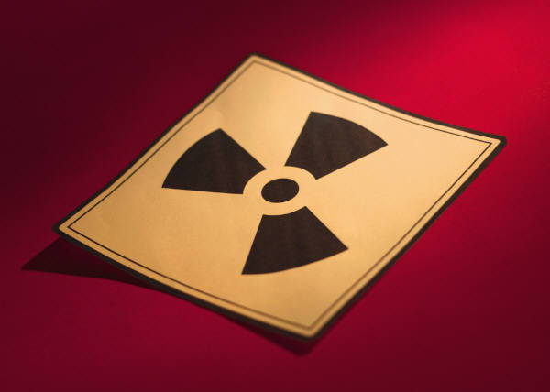
How to limit exposure
Time- Limit the time you are exposed
Distance- Stay as far as away as possible
Shielding- Wear appropriate lead aprons/shield
If available, wear a radiation dosimetry badge to keep track of exposure
Notes:
There are 3 key components to keep in mind when around radiation devices to limit your exposure. These are time, distance, and shielding. Basically, limit how much time you are exposed as much as possible. Stay as far away as you can and still do your job. And wear shielding devices such as lead aprons or lead walls. Remember if you are pregnant, radiation can be very harmful to your fetus. Be sure to consult your supervisor before you go into a setting using radiation.

Slide 36
Prevent radiation fires
Keep devices intact
Monitor equipment for overheating
Avoid contact with fluids
Know the location of fire extinguisher
Notes:
Preventing fires from radiological equipment is similar to all electrical equipment. Keep the device in good working order and report and damage. Keep the equipment away from fluids that could cause a short. Specifically to external radiation equipment, such as C-arms, monitor the devices for overheating. Usually the equipment has a safety feature that causes the device to shutdown if it becomes too hot but this could vary by device or malfunction. A rule of thumb is to stay aware. Monitor your equipment and those around you. Know the settings policy and fire plan as well as fire alarms and extinguishers just in case.

Slide 37
Review
Click to see the answer to each question
1. What are the three necessary points to limiting radiation exposure?
Time, Distance, Shielding
2. What is a possible malfunction in radiological equipment that could cause a fire?
Overheating, Damaged device, Frayed cord
Notes:
Lets review what we learned regarding radiation. Click on the slide to see the answer to each question. For question 2, there are several possible answers. Only a few are listed as suggestions.

Slide 38
Fire Safety in Specialty Locations
Surgical Fires
Fires in patients’ home
Notes:
This is the 4th and final section of this course. Fire in specialty locations. In this section we are doing to focus on 2 areas that you might be providing your services: the operating room and patient’s homes. Both areas have their own special circumstances that may put them at risk for fires.

Slide 39
Fires in the OR
All 3 elements of the fire triangle are present on a normal day in the OR
  Fuel: drapes, towels, plastic
  Heat: ESU, lasers, Argon beams, Microscopes, light sources
  Oxygen: The OR is an oxygen enriched environment: anesthesia machines, OR tanks, Nitrous Oxide
Notes:
In many environments, the 3 elements of the fire triangle can be contained from each other. This is not true in the surgical suite. These elements are present in some form during every case. This slide shows just a few of the many examples of these elements used daily in the OR. Some items such as microscopes or Nitrous Oxide you might not think could aid to a fire. Know that Nitrous is just as flammable as Oxygen and is used frequently in surgery. Microscopes, like all electrical equipment, poses a risk from malfunction.

Slide 40
Preventative Measures
Special care in head, neck, and lung cases
Let alcohol preps dry appropriately
Decrease O2 % when possible to 30%
Decrease O2 for at least a minute before using ESU and other devices
Use moist sponges
Cover patient’s facial hair with non-flammable jelly
Keep sterile water on back table
Notes:
There are many things to be aware of to prevent fires in surgery. Most of these items will not be your responsibility as a vendor in the OR, unless it is your item, but it is always good to have the knowledge and be prepared. You might see a dangerous situation in which you can provide knowledge of these safety measures to prevent an accidental fire.
First off, special care should be used during head, neck and lung cases. This is because oxygen from anesthesia ventilation can pool in these areas under the surgical drapes. Although no area is a good area to receive a burn, fires in a patient’s airway or to his/her face and throat are particularly life-threatening.
Also, now that many facilities have moved to surgical preps that contain alcohol, it is very important to let those preps dry according to the manufacturer's instructions. Alcohol is very flammable and its fumes may get trapped underneath the surgical drapes, which can also cause a fire.
Because oxygen is also very flammable, when possible it is recommended that the anesthesia provider use room air or a concentration of O2 no more than 30%. Unfortunately this is not always possible due to the patient’s condition. Extra attention needs to be paid to these patients because they are at higher risk. With that said, try to decrease oxygen for at least a minute before the use of any heat source, when possible.
Keeping sponges and other items which can act as fuel for a fire moist will also help prevent a fire. This includes a patient’s facial hair. If the surgical site will put the physician in contact with a patient’s hair and it isn’t removed, a non-flammable water-soluble jelly should be used to cover the hair making it non-flammable. Finally in all procedures where an ESU (electrical surgical unit also known as a bovie), laser, or argon beam is going to be used the scrub should keep a bowl of sterile water on the back table.

Slide 41
Preventative Measures (cont)
Only use ESU or lasers when tip is in view
Keep all electrical equipment in standby when not in use, when possible
Keep bovie pencils in provided holsters when not in use and don’t coil wires around clamps
Use shielded bovie tips when necessary, don’t create your own with rubber catheters
Check connections on light sources and never lay an active light on the surgical drapes
Notes:
Continuing on with ways you can prevent a fire in the operating room. Encourage the physician to only use the ESU, laser or other device when the tip is in view. It is very easy to accidently activate a device and cause a fire. With that said, any device that can be put on standby when not in use should be. This is very true for lasers. Also, always placing bovie pencils back in their fire-resistant holsters when not in use should become standard of care. You should also not clamp the bovie pencil in place using a metal clamp. This clamp can heat up from stay electricity from the bovie cord and also cause a burn. In order to prevent a stray burn from a bovie pencil, some physicians like to shield part of the active tip. There are manufactured devices for this purpose that are not flammable. A “homemade” shield such as one from a red rubber catheter should never be used. These items are very flammable and worse yet, may fall of the bovie pencil tip into the patient. Finally, be alert when using light sources, particularly those for endoscopic cases. These devices can become very hot in a manner of seconds and will quick burn through surgical drapes. Always double check the connections when using a light source so it does not inadvertently come lose and cause a fire or burn without anyone realizing it.

Slide 42
Preventative Measures (cont)
Use lowest setting possible on ESU
Use return electrodes for ESU and other devices properly
Use laser safe ET tubes when appropriate
Do not silence alarms
Have regular fire drills and device use and fire prevention in-services
Refer to AORN Guidance Statement: Fire Prevention in the Operating Room
Notes:
Just a few more preventative measures to think about. When using an ESU or other cautery device, you want to try to use the lowest setting possible to prevent tissue damage and lower fire risk. Along with that, using the proper grounding pads are also important. When using lasers, the anesthesia provider should use laser safe endotracheal tubes to lower the fire risk. No one, staff or you, should silence the audible alarms on a device. These are a necessary safety feature that can alert you to accidental activation of a device or malfunction. Finally, there should be routine fire drills and education for everyone in the healthcare setting including vendors such as yourself. A great resource to review all of these preventative measures is the AORN guidance statement Fire Prevention in the Operating Room.

Slide 43
What to do if there is a fire in the OR
Stop the oxygen and go to room air
If the fire is small, smother it
If the fire is large, remove the drapes
Pour water on the site
Get a fire extinguisher and activate the alarm
Deal with injuries or evacuate the room
Notes:
Even in the best prepared situations, fires can still occur. If it does happen it’s important to know what to do. Even if you don’t participate in this process, knowing what is happening can help keep you safe and keep you from impeding the process. First, you want to remove the oxygen from the situation and replace it with room air. It may be necessary to remove the intubation device from the patient as well. If the fire is small, it can be smothered with a wet towel but if it is large, especially on the surgical drapes, then remove them from the patient. Take the sterile water from the back table and pour on the burned site. Use a fire extinguisher if necessary to put out the flames to the surgical drape and activate the fire alarm. Then deal with the injuries to the patient and/or staff. When necessary, you may need to evacuate the room. If this happens be sure to follow the facility’s fire plan.

Slide 44

Fire Safety Video
The Anesthesia Patient Safety Foundation has provided an 18 minute video that demonstrates all the techniques we just discussed.
Please double click on the black box to the right to watch the video.
Notes:
The following video from the Anesthesia Patient Safety Foundation provides information regarding how to prevent and manage an OR fire. Many of the techniques we just discussed are demonstrated in this video so you can see the process in action. Please double click on the black box to the right of the slide to start this 18 minute video. A complementary copy of this video can be downloaded at http://www.apsf.org/resources_video.php

Slide 45
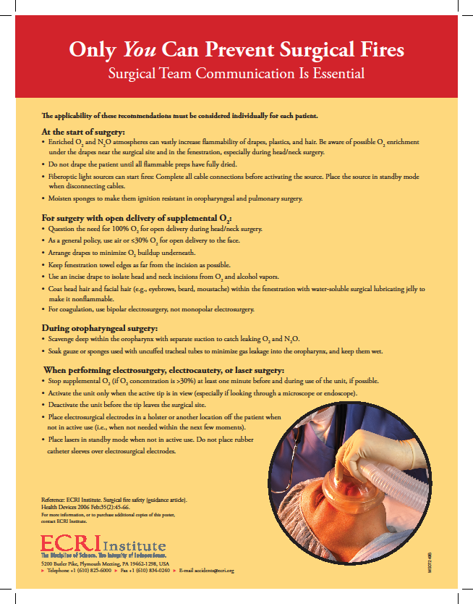
Additional Resources
ECRI poster
The Emergency Care Research Institute (ERCI) is a non-profit agency that helps manage safe medical equipment use.
Notes:
Another resource to remind you of how to prevent and manage a surgical fire is the “Only you can prevent surgical fires” poster put out by the emergency care research institute. This poster can be downloaded from their site for reference at https://www.ECRI.org

Slide 46
Review
Click to see the answer to each question
Name 6 preventative measures to decrease the risk of fire in the OR
  Use holster provided with bovie pencils
  Keep devices on stand-by when possible
  Only use devices when you can see the tip
  Do not use “home-made” shields on bovie pencil tips
  Let alcohol preps completely dry
  Limit concentration of oxygen as much as possible
Notes:
Lets review some of the prevention techniques we have learned in this section regarding preventing fires in the operating room. Name 6 preventative measures of the numerous provided. Click on the slide to see examples of some of the possible answers.

Slide 47
Fire Prevention in Patient’s Homes
Several medical devices can be set up for home health use (carry same risks as any electrical device)
Risks associated with oxygen therapy at home
Fire extinguishers for home use
Notes:
Fire risks with medical devices are not limited to their use in healthcare facilities. Many medical devices are sent home with the patient for home health use. Even though staff are assigned to these patients and you as the vendor of the device may educate the patients, often they are alone with the device. There are risks both you and the patient should be aware of that are unique to the home setting. As a result, it is recommended that patients keep a fire extinguisher for home use as well.

Slide 48
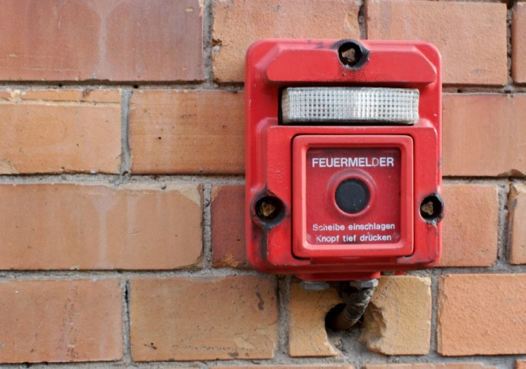
Fire Risks at Home
Oxygen therapy- smoking, candles, stoves, heaters, sparks from equipment, hairspray or other flammable cosmetic items
Malfunctions in equipment
Covering devices or exposure to fluids
Damage to devices or oxygen tanks (explosion)
Notes:
Many patients go home on oxygen therapy. This can be very dangerous due to items in the home that the patient may not see as a risk. As discussed before, smoking with the use of oxygen is never advisable but the use of candles and other equipment that may cause a spark can cause a fire in the home if the patient is using oxygen. Even using oxygen in a car that is poorly ventilated can cause a fire. As with any electrical piece of equipment, the patient should be advised not to cover or store liquids on any medical device that could overheat or otherwise be damaged.

Slide 49
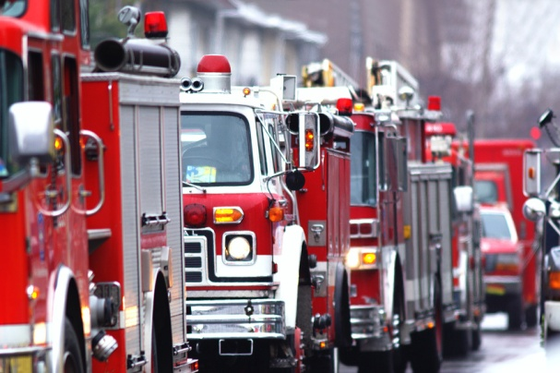
If there is a fire…
If possible, unplug malfunctioning device
Turn off oxygen if in use
Stop, drop, and roll
Call 911- activate fire alarm if available
Close the door where fire is located
If possible, extinguish the fire
Notes:
Since your patient may not be a healthcare worker, he/she may not have been exposed to fire safety training. If you are there when a fire breaks out in a patient’s home, you need to know what to do. If possible, remove the power to a malfunctioning device and/or turn off any oxygen in use in the area. If you are on fire, stop drop and roll… do not run which can spread the flames. If the fire is small, extinguish the fire using the appropriate method based on the type of fire. If it is too large, close the door to contain it. Since there will not be a set fire plan or Code Red to call, you need to call 911 to activated the fire department response if the fire is too large for you to extinguish.

Slide 50
Review
Click to see the answer to each question
What are 3 items unique to the home setting that can increase fire risks?
  Candles
  Hairspray
  Cooking Stove
Notes:
One last review. What are 3 of the many items we have discussed that are unique to the home setting that when paired with medical devices, such as oxygen therapy, can be a fire risk? Click on the slide to see examples of possible answers.

Slide 51

The End
Notes:
Thank you for your attention. Hopefully this course has provided you with the necessary tools to conduct your business safely in the presence of various fire risks.

